Slide 1


Self-learning MRI with MR-zero How end-to-end learning inspires sequence design Prof. Dr. Moritz Zaiss Neuroradiology, University Hospital Erlangen Department of AI in biomedical engineering

Slide 2
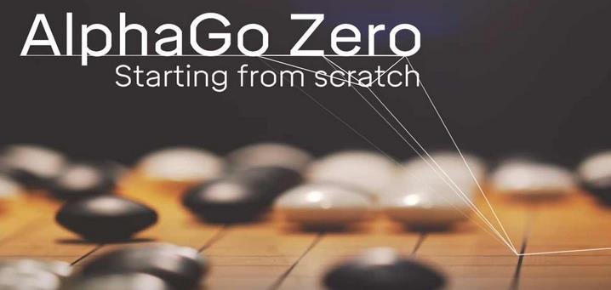
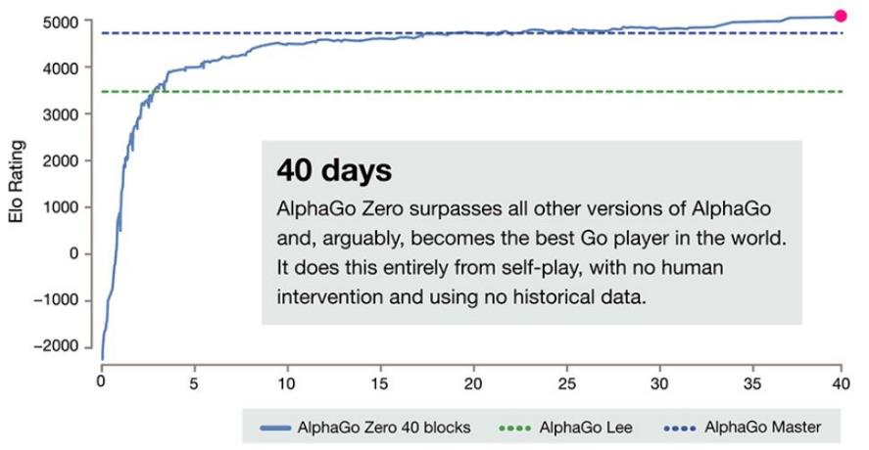
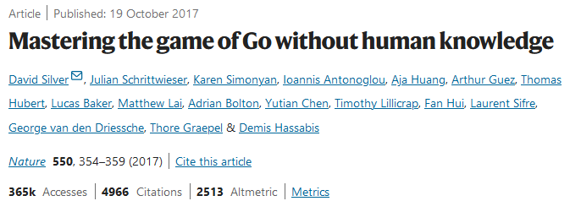
Self-learning MRI MR-zero inspired by
Winning
Condition
Rules
Strategy
https://the-decoder.de/googles-neue-super-ki-lernt-in-40-tagen-tausende-jahre-menschliches-wissen/

Slide 3
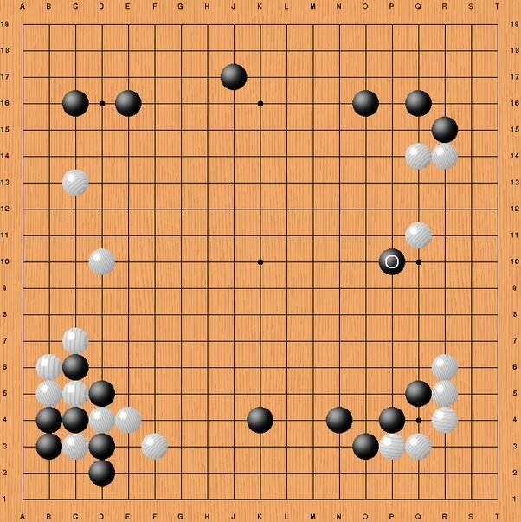
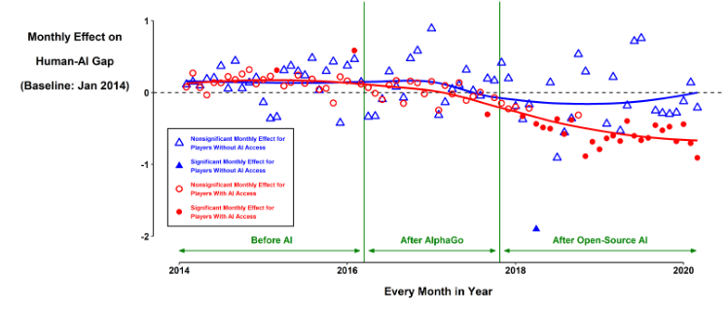
MR-zero – the big picture
Move 37 of AlphaGo surprised the world's best Go players, including Lee Sedol.
"That's a very strange move, I thought it was a mistake.“
“Its not a human move, I’ve never seen a human play this move.
So beautiful. Beautiful. Beautiful.”
Shin et al. Proceedings of the Annual Meeting of the Cognitive Science Society, 2021 https://escholarship.org/uc/item/6q05n7pz
https://www.quora.com/What-was-the-significance-of-move-37-and-move-78-in-Go-AlphaGo-versus-Lee-Sedol
https://the-decoder.de/googles-neue-super-ki-lernt-in-40-tagen-tausende-jahre-menschliches-wissen/

Slide 4
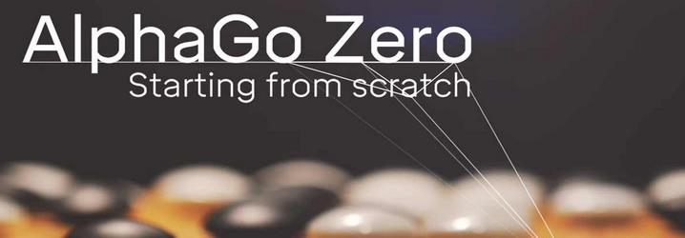

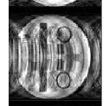
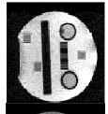
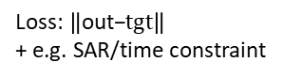
MR-zero
MR
Winning
Condition
Rules
Strategy
Bloch Equations
MRI
sequence
Target data
Contrast of interest
out
tgt
Loss:$\left\|\text{out}\text{−}tgt\right\|$
+ e.g. SAR/time constraint
AlphaGo Zero: Reinforcement Learning
MR-zero: supervised learning

Slide 5

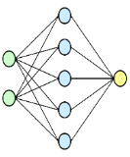
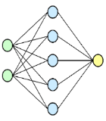
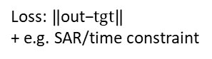

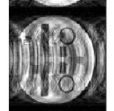
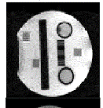
MR-zero
MR
Differentiable Digital MR Twin
Spin system
PD, T1, T2, T2‘, B0+χ ,B1, diffusion, …
MRI scanner
& sequence
Reconstruction
k-space to image space,
image to parametric maps
Target data
Contrast of interest
out
tgt
NN mapping
„FFT“
Differentiable
Bloch simulation
Loss:$\left\|\text{out}\text{−}tgt\right\|$
+ e.g. SAR/time constraint
Updates
MR sequence
Updates Reconstruction
+ Inference
Endres J, Weinmüller S, Dang HN, Zaiss M. Phase distribution graphs (PDG) for fast, differentiable, and spatially encoded Bloch simulations of arbitrary MRI sequences. Magn Reson Med. 2024 Apr 4. doi: 10.1002/mrm.30055.
EPG: echo top
PDG: echo shape
gradient encoding
B0/T2*dephasing
Gradient descent / Backpropagation
KomaMRI.jl, MR-STAT, …

Slide 6
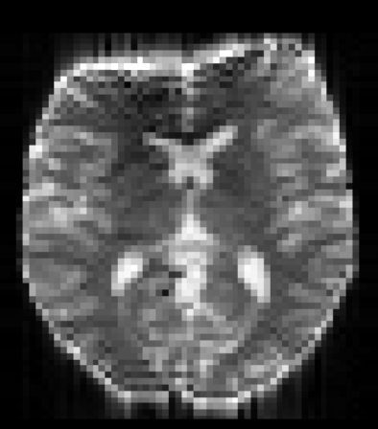
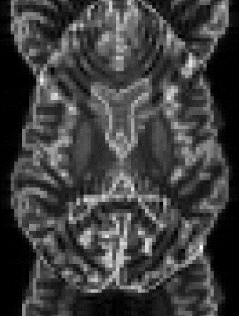
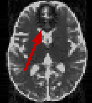
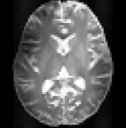
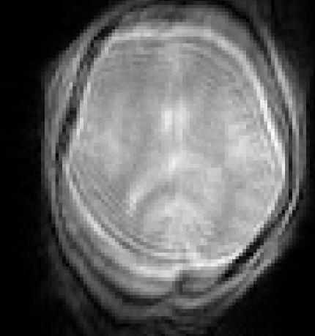

PDG - Fast, differentiable, and spatially encoded Bloch simulations of arbitrary MRI sequences
SE-EPI
GRE-EPI
bSSFP
TSE 7T
FLASH
B0 distortion/ cancellation
ghosts
stop band artifact
B1 inhom. artifact
Motion artifact
pip install MRzeroCore
mrzero-core.readthedocs.io

Slide 7

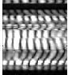
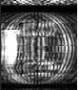
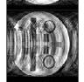
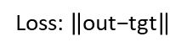
Task 1: re-invent encoding
Spin system
PD, T1, T2, T2‘, B0+χ ,B1, diffusion, …
MRI scanner
& sequence
Reconstruction
k-space to image space,
image to parametric maps
Target data
Contrast of interest
FFT
Differentiable
Bloch simulation
Loss:$\left\|\text{out}\text{−}\text{t}\text{g}\text{t}\right\|$
Updates
MR sequence
Updates Reconstruction
+ Inference
Gradient descent / Backpropagation
Differentiable Digital Twin of the MRI process
Pytorch, autograd, adam optimizer, pypulseq

Slide 8
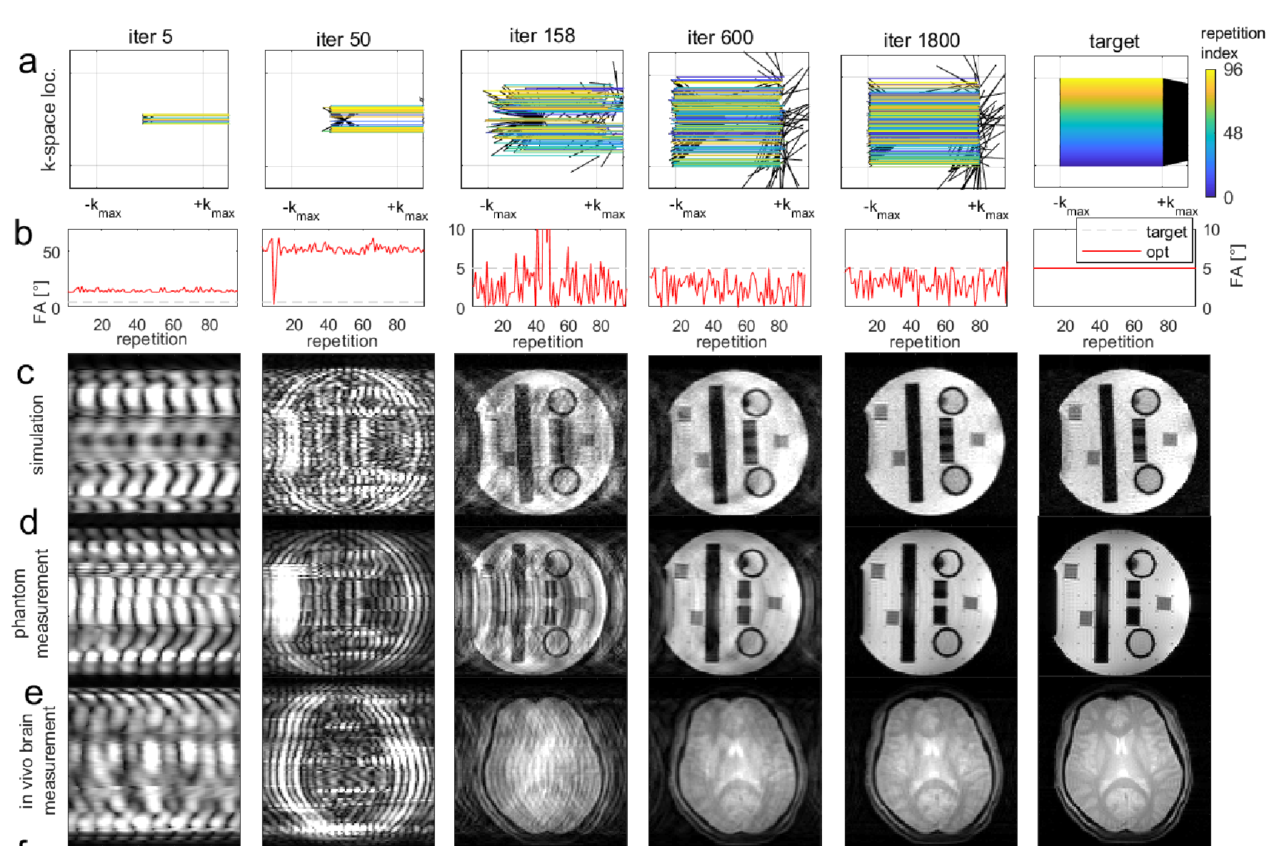
Task 1: re-invent cartesian encoding
Re-invent MRI

Slide 9
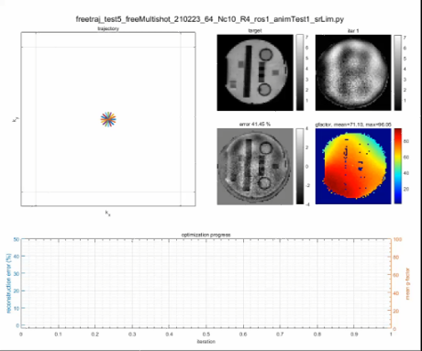
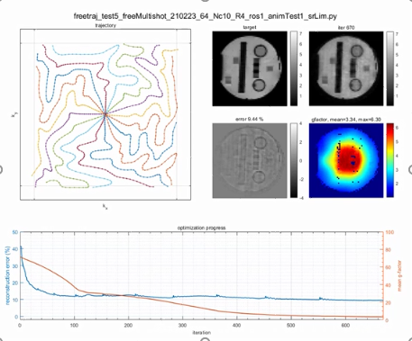
Task 2: arbitrary encoding
Similar optimizations to
Snopy
Bjork
Pilote
Sparkling
Etc.
See Demo by Felix Glang
Glang et al. ISMRM 2021

Slide 10
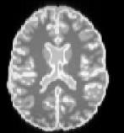
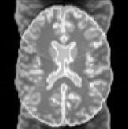
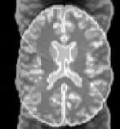
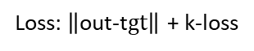
Task 3: encoding with imperfect gradients
With eddy currents
and no correction:
Spin system
PD, T1, T2, T2‘, B0+χ ,B1, diffusion, …
MRI scanner
& sequence
Reconstruction
k-space to image space
Target data
out
tgt
FFT
GIRF –Model
Differentiable
Bloch simulation
Loss:$\left\|\text{out}\text{−}\text{t}gt\right\|$ + k-loss

Slide 11
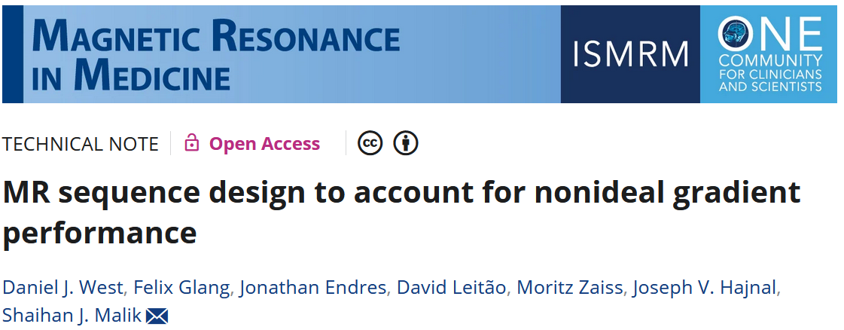
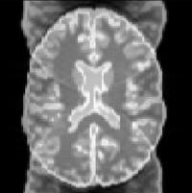
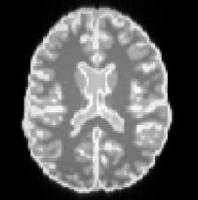
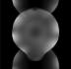
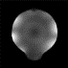
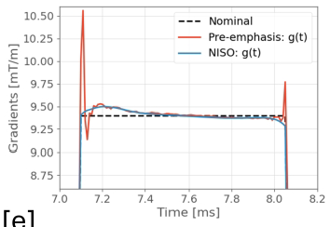
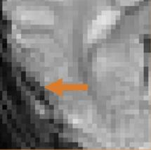
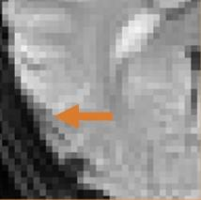
Task 3: encoding with imperfect gradients
in silico
in vitro
Re-invent adaptive pre-emphasis
by free arbitrary gradients
Compromise quality/demand:
Less demanding solution
Broader application shorter TE, higher res, old hardware
in vivo

Slide 12
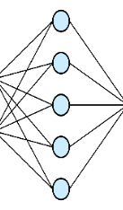
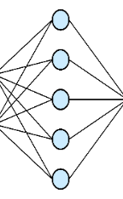
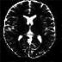
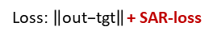
Task 4: TSE: same image – lower SAR
Spin system
PD, T1, T2, T2‘, B0+χ ,B1, diffusion, …
MRI scanner
& sequence
Reconstruction
k-space to image space
Target data
Contrast of interest
TSE
out
tgt
SAR: 30%
SAR: 100%
FFT
Differentiable
Bloch simulation
Loss:$\left\|\text{out}\text{−}\text{tgt}\right\|$ + SAR-loss

Slide 13
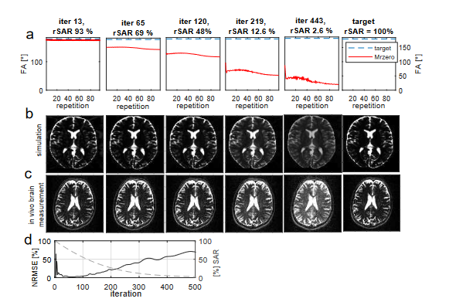
Task 4: TSE - same image –lower SAR
Re-inventing TRAPS Hennig et al. MRM 2003

Slide 14
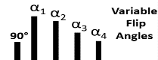
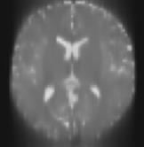
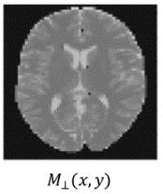
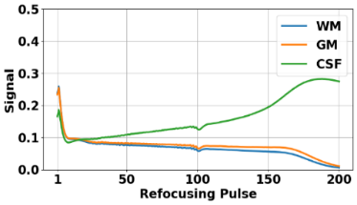
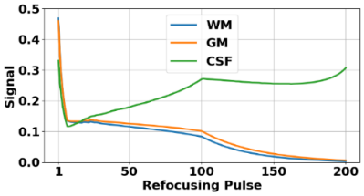
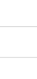

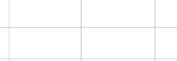




Task 5: TSE - Deblurring
Spin system
PD, T1, T2, T2‘, B0+χ ,B1, diffusion, …
MRI scanner
& sequence
Reconstruction
k-space to image space,
image to parametric maps
Target data
Contrast of interest
out
tgt
DENSENET
FFT
Differentiable
Bloch simulation
Loss:$\left\|\text{out}−tgt\right\|$ + λ∙SAR + λ∙PSF
vFA: k-space dependent!
NN dependent
NN: vFA-tailored
Dang et al. MRM 2023

Slide 15


2D TSE - T2w at 3T - Deblurring
RARE
RARE-zero
RARE-zero
16-shot TSE
TSE
0.8 s
0.8 s
0.8 s
192 s
330 s
„Physics-informed
vFA-tailored NN“
Dang et al. MRM 2023

Slide 16






3D TSE FLAIR vendor sequence with pTx at 7T
Standard
Trade-off-
optimization
0.7mm³
8min
sharpness
SNR
contrast fidelity
SAR
Loss:
$\left\|\text{out}−tgt\right\|$ + λ∙SNR + λ∙PSF + λ∙SAR
https://teaching.thehumanbrain.info/neuroanatomie.php?kap=12
Dawood et al. MRM 2025

Slide 17






Task 6: pTx TSE and DSC / DESC
Spin system
PD, T1, T2, T2‘, B0+χ ,B1+, diffusion, …
MRI scanner
& sequence
Reconstruction
k-space to image space,
image to parametric maps
Target data
Contrast of interest
TSE
FFT
Differentiable
Bloch simulation
Loss:$\left\|\text{out}\text{−}\text{tgt}\right\|$ + SAR-loss
channel-wise B1+

Slide 18


Task 6: pTx TSE and DSC / DESC
Spin system
PD, T1, T2, T2‘, B0+χ ,B1+, diffusion, …
MRI scanner
& sequence
Reconstruction
k-space to image space,
image to parametric maps
Target data
Contrast of interest
TSE
FFT
Differentiable
Bloch simulation
Loss:$\left\|\text{out}\text{−}\text{tgt}\right\|$ + SAR-loss
channel-wise B1+
Direct encoded signal control for pTx -Weinmüller, Endres et al. ISMRM 2025

Slide 19





Task 7: spiral TSE at 7T with DESC
Spin system
PD, T1, T2, T2‘, B0+χ ,B1, diffusion, …
MRI scanner
& sequence
Reconstruction
k-space to image space,
image to parametric maps
Target data
Contrast of interest
Spiral TSE
FFT
Differentiable
Bloch simulation
Loss:$\left\|\text{out}\text{−}\text{tgt}\right\|$ + SAR-loss
static B1 shim
DESC
channel-wise B1+
seq
from
github.com/HennigJue
mr0(seq)
optimize B1 shim for each pulse
Hennig et al. MRM 2022
7T spiral TSE
Weinmüller et al. ESMRMB 2025

Slide 20
Task 8: FLASH – Fast low angle shot MRI
Problem: Transient signal decays is NOT Lock-Looker
Transient FLASH sequence like MPRAGE, or snapshot FLASH or LL-T1 quantification
assume exponential decay of signal to the FLASH steady state.
Weinmüller et al. MRM 2024

Slide 21

Task 8: FLASH – Fast low angle shot MRI
Problem: Transient signal decays is NOT Lock-Looker
Even under ideal spoiling Gradient and rf spoiling with quadratic phase cycling.
And this is measurable. (Epstein et al. MRM 1996)
Weinmüller et al. MRM 2024

Slide 22
Task 8: Epstein-Artifact in transient FLASH (FA=16°)
Simon.weinmueller@uk-erlangen.de
„Epstein Artifact“
K-space filter
Weinmüller et al. MRM 2024

Slide 23



Task 8: 2D transient FLASH
Spin system
PD, T1, T2, T2‘, B0+χ ,B1, diffusion, …
MRI scanner
& sequence
Reconstruction
k-space to image space,
image to parametric maps
Target data
Contrast of interest
FFT
Differentiable
Bloch simulation
Loss:$\left\|\text{output}\text{−}\text{target}\right\|$
+ e.g. time constraint
Updates
MR sequence
Updates Reconstruction
+ Inference
Weinmüller et al. MRM 2024

Slide 24
Task 8: 2D transient FLASH
Spin system
PD, T1, T2, T2‘, B0+χ ,B1, diffusion, …
MRI scanner
& sequence
Reconstruction
k-space to image space,
image to parametric maps
Target data
Contrast of interest
Differentiable
Bloch simulation
Loss:$\left\|\text{output}\text{−}\text{target}\right\|$
+ e.g. time constraint
Updates
MR sequence
Updates Reconstruction
+ Inference
Weinmüller et al. MRM 2024

Slide 25

Task 8: 2D transient FLASH

Slide 26

Task 8: Solved
Weinmüller et al. MRM 2024

Slide 27




Conclusion
MR-zero is a flexible and general framework for learning-based end-to-end MR sequence design
Paradigm shift : Rules + Goal = Strategy
problem formulation by target image (+ λ∙x)
Inspires sequence design regarding…
flexible compromises between quality and demand
tailored solutions of sequence-NN-pairs
questioning textbook knowledge like quadratic phase cycling
out
tgt
NN
FFT

Slide 28
Self-learning MRI MR-zero inspired by
MR
Super Human MRI?
Not Yet...
https://the-decoder.de/googles-neue-super-ki-lernt-in-40-tagen-tausende-jahre-menschliches-wissen/

Slide 29



Thank you for listening!
Thanks to my
research group!
and
Felix Glang
Daniel West
Shaihan Malik
Nam Dang
FLASH, Simon Weinmüller
Jonathan Endres, PDG
Peter Dawood, TSE
Martin Freudensprung, pTx-Pulseq

Slide 30
We have open positions! moritz.zaiss@fau.de
pip install MRzeroCore
mrzero-core.readthedocs.io

